Slide 1
Counting
Part 2 – The Pigeonhole Principle

Slide 2
Understanding the principle

Slide 3
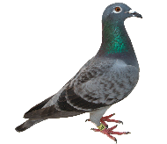
Understanding the Principle
12 pigeonholes
13 pigeons

Slide 4

Understanding the Principle

Slide 5
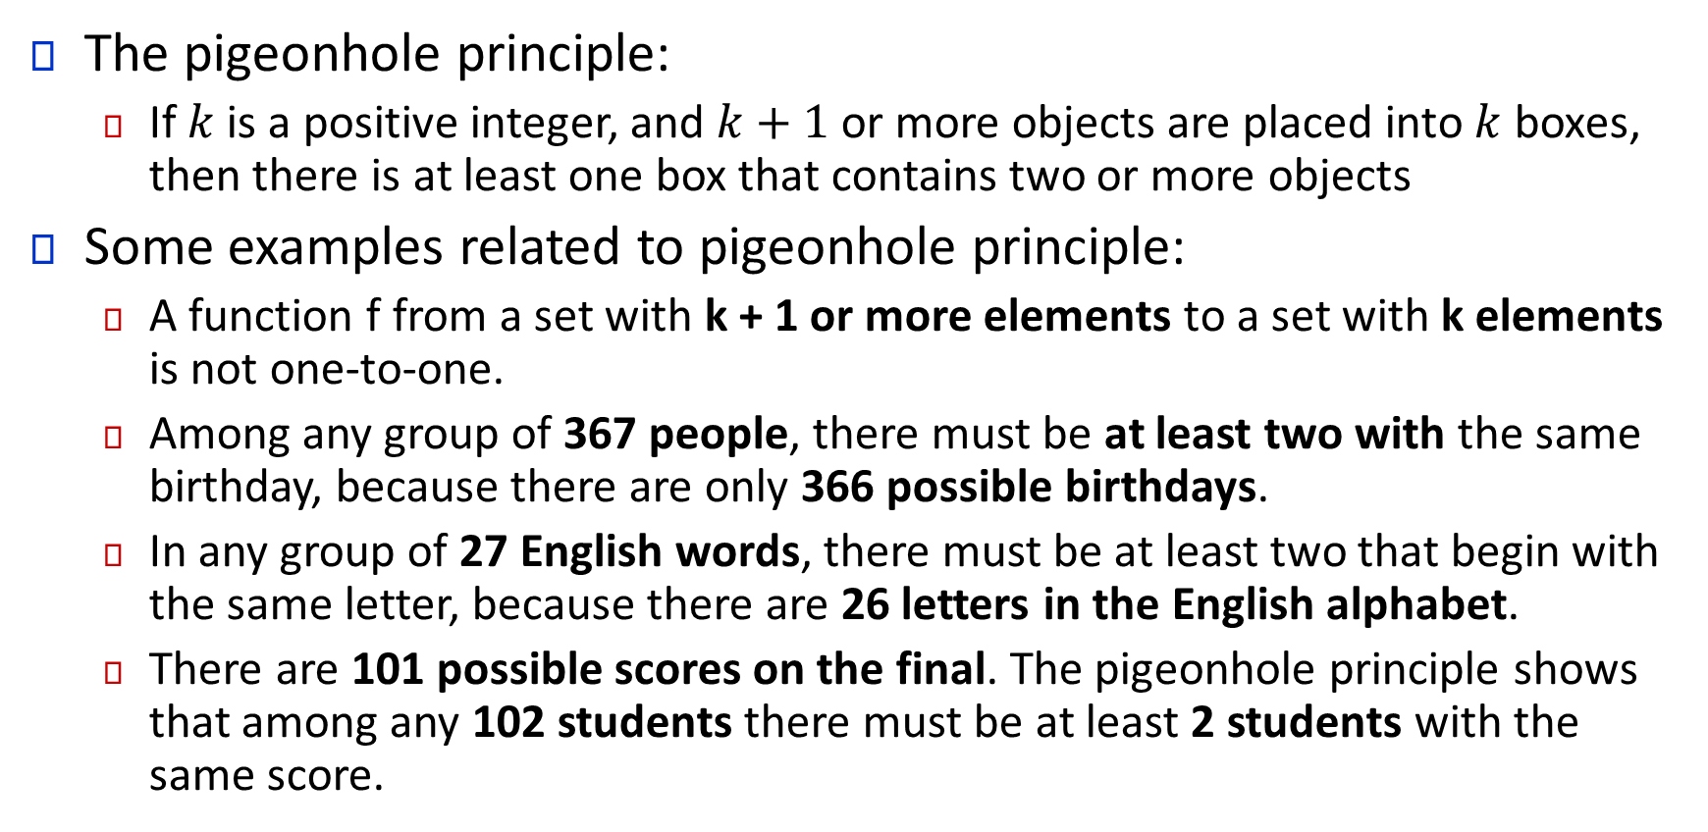
Understanding the Principle
The pigeonhole principle:
If $k$ is a positive integer, and $k+1$ or more objects are placed into $k$ boxes, then there is at least one box that contains two or more objects
Some examples related to pigeonhole principle:
A function f from a set with k + 1 or more elements to a set with k elements is not one-to-one.
Among any group of 367 people, there must be at least two with the same birthday, because there are only 366 possible birthdays.
In any group of 27 English words, there must be at least two that begin with the same letter, because there are 26 letters in the English alphabet.
There are 101 possible scores on the final. The pigeonhole principle shows that among any 102 students there must be at least 2 students with the same score.

Slide 6
The generalized pigeonhole principle

Slide 7
The Generalized Pigeonhole Principle
If N objects are placed into k boxes, then there is at least one box containing at least ⌈N∕k⌉ objects.
Note that the objects are more than the elements
If N elements of set x are mapped to k elements of set y and N>k , then there are ⌈N∕k⌉ elements of set x that are mapped to the same element y.
Let us take a look at a simple example to understand the generalized pigeonhole principle

Slide 8
The Generalized Pigeonhole Principle
Among 100 people there are at least ⌈100∕12⌉ = 9 who were born in the same month.
Now let us take a look at a question:
What is the minimum number of students required in a discrete mathematics class to be sure that at least six will receive the same grade, if there are five possible grades, A, B, C, D, and F?

Slide 9
The Generalized Pigeonhole Principle
A bowl contains 10 red balls and 10 blue balls. A woman selects balls at random without looking at them.
a) How many balls must she select to be sure of having at least three balls of the same color?
b) How many balls must she select to be sure of having at least three blue balls?
Show that if there are 30 students in a class, then at least two have last names that begin with the same letter.

Slide 10
The Generalized Pigeonhole Principle
How many cards must be selected from a standard deck of 52 cards to guarantee that at least three cards of the same suit are chosen?

Slide 11

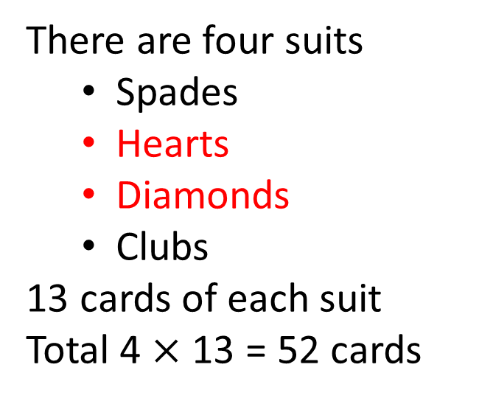
The Generalized Pigeonhole Principle
How many cards must be selected from a standard deck of 52 cards to guarantee that at least three cards of the same suit are chosen?
There are four suits
Spades
Hearts
Diamonds
Clubs
13 cards of each suit
Total 4 $×$ 13 = 52 cards

Slide 12
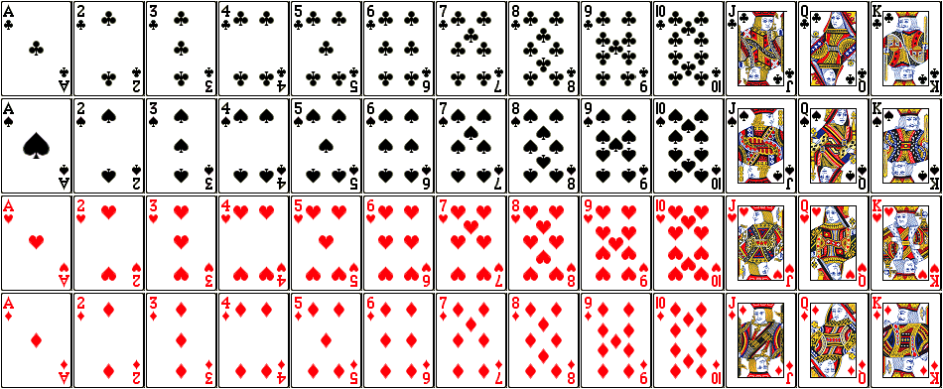
The Generalized Pigeonhole Principle

Slide 13
The Generalized Pigeonhole Principle
How many cards must be selected from a standard deck of 52 cards to guarantee that at least three cards of the same suit are chosen?

Slide 14
The Generalized Pigeonhole Principle
How many must be selected from a standard deck of 52 cards to guarantee that at least three hearts are selected?

Slide 15
The Generalized Pigeonhole Principle
How many must be selected from a standard deck of 52 cards to guarantee that at least three hearts are selected?
One particular suit/group

Slide 16
The Generalized Pigeonhole Principle
A drawer contains a dozen brown socks and a dozen black socks, all unmatched. A man takes socks out at random in the dark.
a) How many socks must he take out to be sure that he has at least two socks of the same color?
b) How many socks must he take out to be sure that he has at least two black socks?

Slide 17
The Generalized Pigeonhole Principle
Pigeons are kept in a multi storied pigeon house. Pigeon holes in this house are specified by the row, column, and floor. There are 50 rows, 85 columns in each rows, and 5 floors throughout the pigeon house. What is the least number of pigeons the pigeon house can have so that at least two pigeons must stay in the same house?

Slide 18
The Generalized Pigeonhole Principle
What is the least number of area codes needed to guarantee that the 25 million phones in a state can be assigned distinct 10-digit telephone numbers? (Assume that telephone numbers are of the form NXX-NXX-XXXX, where the first three digits form the area code, N represents a digit from 2 to 9 inclusive, and X represents any digit.)

Slide 19
Thank You

